Slide 1
QUANTUM DRIVEN SECURE PASSWORD MANAGER USING AWS CLOUD SERVICES
Domain: Cryptography
Group Members:
N Aruntej
M Sharath Simha Reddy
Project Supervisor:
Ms.K.Geetha

Slide 2
MOTIVATION
🧠 Future-Proof with Quantum
🔐 Weak Security = Data at Risk
⚛ Legacy Systems are Vulnerable
90%
32M
240%
Customer Satisfication
Active Users

Slide 3
PROBLEM STATEMENT
Current Password Systems are Vulnerable:
🔑 Quantum Key Cracking: Future decryption of stored passwords.
👤 Insecure Key Exchange: Risk of interception in transit.
🚫 Weak Encryption: Vulnerable to brute-force attacks.

Slide 4
OBJECTIVE
To overcome existing vulnerabilities, our system utilizes:
🔐 Quantum-Safe Encryption: PQC algorithms (Kyber/NTRU) protect against future threats.
🔑 Hybrid Encryption: AES-256 + PQC Key Encapsulation for robust security.
👤 Role-Based Access Control: Ensures authorized access only.
☁️ Secure Cloud Storage: Encrypted password data stored on AWS S3.
90%
32M
Customer Satisfication
Active Users

Slide 5
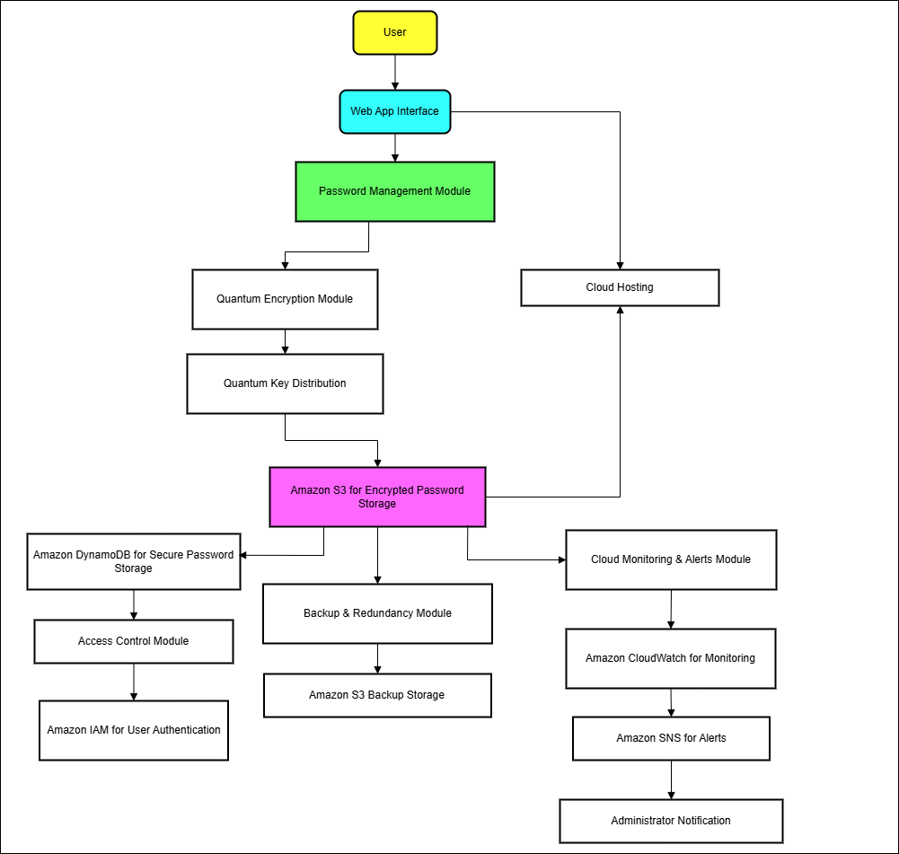
ARCHITECTURE DIAGRAM
d
90%
Customer Satisfication

Slide 6
OUTCOME
🔐 Successfully implemented quantum-resistant password management using a hybrid encryption scheme (AES-256 + PQC), enhancing protection against future quantum threats.
🔑 Established secure key exchange leveraging simulated QKD protocols on Amazon Braket, demonstrating the potential of quantum-enhanced key distribution.
☁️ Built a secure password data storage system on AWS S3, ensuring that only authorized users can retrieve their encrypted credentials.
🛡️ Implemented role-based access control, enforcing strict access policies and preventing unauthorized access to password data.

Slide 7
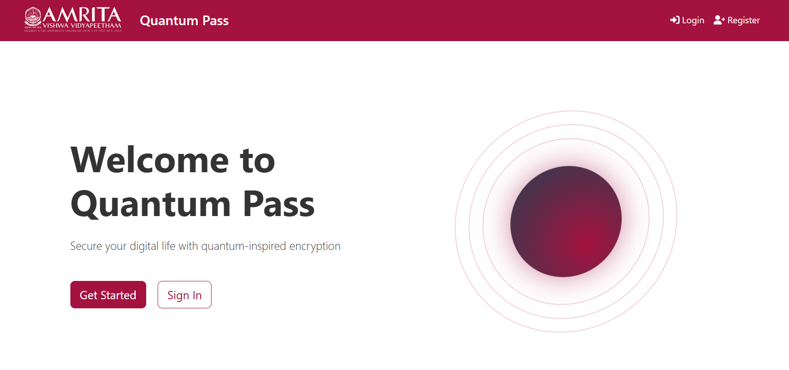
HOMEPAGE
90%
Customer Satisfication

Slide 8
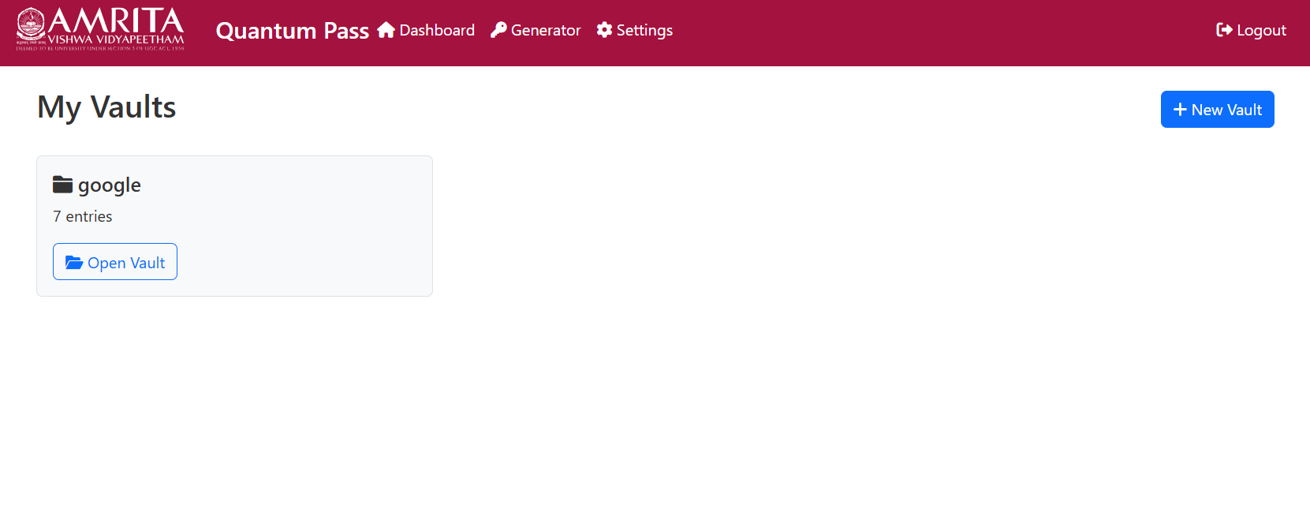
Password Vaults
90%
Customer Satisfication

Slide 9
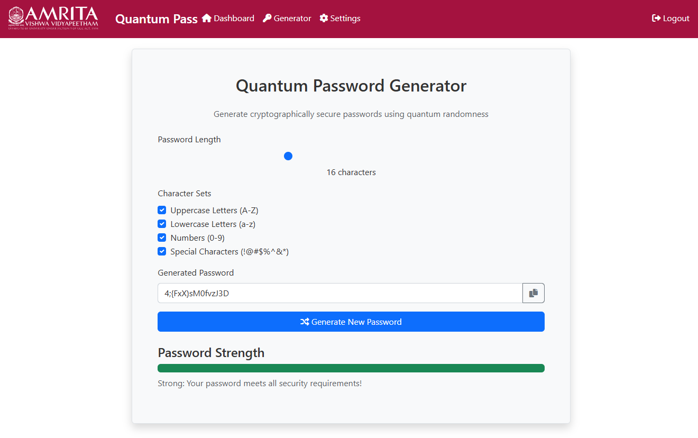
Password Generator
90%
Customer Satisfication

